Slide 1
YCHS Key Club Meeting
September 26th, 2017
Division 14 Blue Robots

Slide 2
Pledges
KEY CLUB PLEDGE
I pledge on my honor to uphold the objects of Key Club International;
To build my home school and community;
To serve my nation and god;
And to combat all forces which tend to undermine these institutions

Slide 3
Recap of Events
Region Training Conference
Cherry Blossom Listing Grand Opening

Slide 4
SAVE THE DATES! Major Events!
NEXT EVENT: Fall Rally North – October 23rd
Candidate Training Conference (CTC) – December 9th
District Officer Candidate Training Conference (DOCTC) – December 10th
Conclave - January
District Convention (DCON) – April 13-15 in Reno, NV
CNH Division 14 Blue Robots

Slide 5
Region/ Division Events
Fall Rally North 2017
**Must complete a minimum of 10 service hours by OCTOBER ^{21st} to attend**
Have until October 6th to be paid
Cost: $34
@ Six Flags Discovery Kingdom
CNH Division 14 Blue Robots

Slide 6
Region/ Division Events
Fall Rally North 2017
What is it and why should you go?
(Hint: Not just because it’s at Six Flags!!)
Fall Rally North is a rally to raise money for the Pediatric Trauma Program. It’s the biggest fundraiser of the entire year, and we even auction off Lieutenant Governors, Leadership Team Members, and Executives. It is one big spirit competition where Divisions get to dress up in their favorite spirit wear and show off their spirit gear. You also get to meet Key Clubbers just like you from all over NorCal and Northern Nevada, and hopefully make new friends!
CNH Division 14 Blue Robots

Slide 7
Upcoming Events
Bake Sale!
This Friday @ lunch
By the food trucks
Bring an item for 1 service hour (ie. cupcakes, cookies, brownies)
*Only 5 people to bring baked goods
4 people to work booth
CNH Division 14 Blue Robots

Slide 8
Upcoming Events
☺***Glam Girls***☺
Guest Speaker, Kathy
CNH Division 14 Blue Robots

Slide 9
Upcoming Events
Riverbend Afterschool Tutoring
Mondays – Thursdays
Starting next week
CNH Division 14 Blue Robots

Slide 10
Upcoming Events
Float Building
October 3rd-5th
In quad
3:30pm – 7:30pm
CNH Division 14 Blue Robots

Slide 11
Upcoming Events
Rock-M-Sock-M Float
Walking in the homecoming parade with the other floats (October 6th)
Open for members’ ideas
CNH Division 14 Blue Robots

Slide 12
Upcoming Events
Trick or Treat Boxes for UNICEF
Handing out next week
CNH Division 14 Blue Robots

Slide 13
Treasurer’s Report
Club dues
$11.50
$3.50 donation to club
CNH Division 14 Blue Robots

Slide 14
Friendly Reminders
Please make sure you sign in with the event chair when you get to a service event or else you hours WILL NOT be counted!
Please make sure that if you sign up for an event, you come because when you sign up you are making a commitment and your other members will be counting on you!
If you signed up for an event, but cannot make it to the event, make sure you let an officer, advisor, or the event chair know!
If you did not sign up for an event, but are planning on attending, please contact an officer, advisor, or the event chair, letting us know you will be attending
CNH Division 14 Blue Robots

Slide 15
Contact Us
OFFICER CONTACT INFORMATION
Lieutenant Governor – d14.cnhkc.ltg@gmail.com
PRESIDENT – yc.kc.president@gmail.com
VICE PRESIDENT – yc.kc.vicepres@gmail.com
SECRETARY – yc.kc.secretary@gmail.com
TREASURER – yc.kc.treasurer@gmail.com
EDITOR – yc.kc.editor@gmail.com
IF YOU HAVE ANY PICTURES FROM SERVICE EVENTS, WE WANT THEM!!! PLEASE SEND THEM TO THE CLUB EDITOR, OR OTHER OFFICERS SO WE CAN PUT THEM IN NEWSLETTERS, THE CLUB WEBSITE, ETC.!!!
CNH Division 14 Blue Robots

Slide 16
Chair Reminders
IF YOU CHAIR AN EVENT:
Please make sure you send the ACCURATE hours report to the club secretary, MAISIE, by EMAIL
yc.kc.secretary@gmail.com
CNH Division 14 Blue Robots

Slide 17
Social Media
@ychskeyclub
@ychskc
http://goo.gl/XOOn4e
Enter #: 81010
Text: @yckc
CNH Division 14 Blue Robots

Slide 18
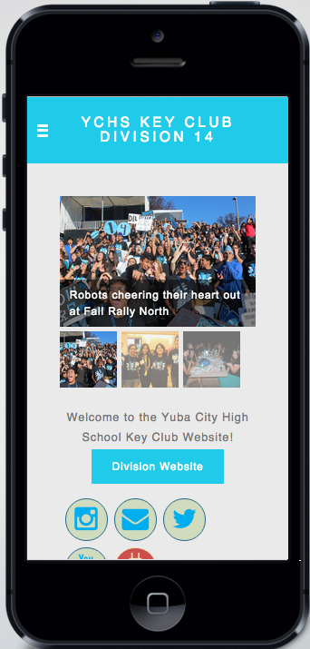
Social Media
WEBSITE
ychskeyclub14.weebly.com
CNH Division 14 Blue Robots

Slide 19
Questions?
Compliments?
Jokes?
Concerns?
Comments?
CNH Division 14 Blue Robots

