Slide 1
YCHS Key Club Meeting
October 31st, 2017
Division 14 Blue Robots

Slide 2
Pledges
KEY CLUB PLEDGE
I pledge on my honor to uphold the objects of Key Club International;
To build my home school and community;
To serve my nation and god;
And to combat all forces which tend to undermine these institutions

Slide 3
Recap Events
Multicultural Assembly
Riverbend School Tutoring
Glam Girls
First Union Methodist Church
Playzeum
Veterens’ Dinner
CNH Division 14 Blue Robots

Slide 4
SAVE THE DATES! Major Events!
NEXT EVENT: Candidate Training Conference (CTC) – December 9th
District Officer Candidate Training Conference (DOCTC) – December 10th
Conclave - January
District Convention (DCON) – April 13-15 in Reno, NV
CNH Division 14 Blue Robots

Slide 5
Upcoming Events
Riverbend School Tutoring
Mondays – Thursdays
3:30-4:45
Please check in Juan Juarez
CNH Division 14 Blue Robots

Slide 6
Upcoming Events
Pumpkin Drop Contest
November 4th (THIS Saturday)
1st Shift: 1PM-4PM
2nd Shift: 4PM-8PM
1980 S Walton Ave, Yuba City, CA, 95591 (Playezeum Yuba Sutter)
*Running booths and helping with the contest*
CNH Division 14 Blue Robots

Slide 7
Upcoming Events
Playzeum
Sign up to volunteer @ yubasutterplay.org
Please check in with Staci Howell
Located @ 1980 S Walton Ave, Yuba City, CA, 95591
CNH Division 14 Blue Robots

Slide 8
Upcoming Events
KEY CLUB WEEK
November 6-10, 2017
Thursday 11/9/2017
Friday 11/10/2017

Slide 9
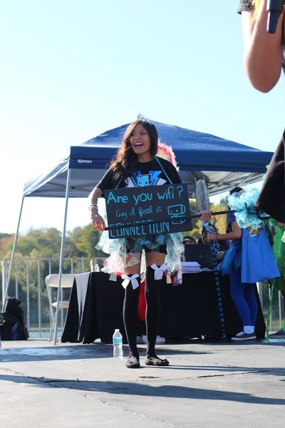
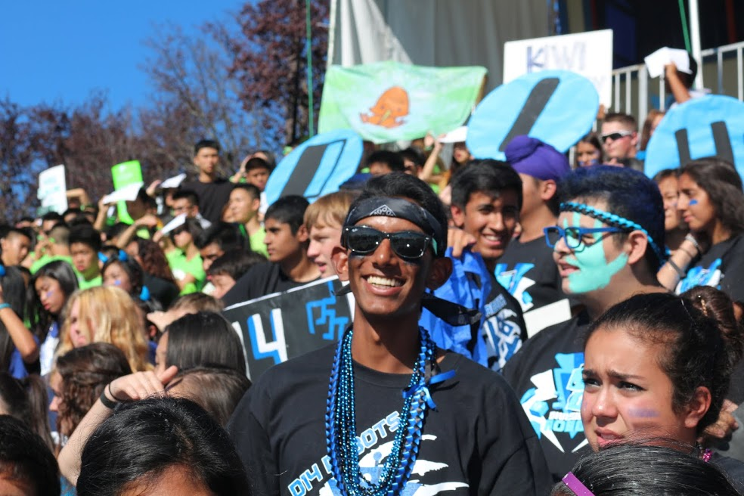
Upcoming Events
Key Club Week (Nov. 6th)
Monday- Wear your spirit gear!!!
CNH Division 14 Blue Robots

Slide 10
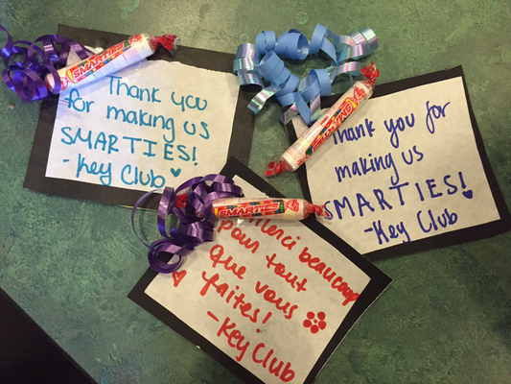
Upcoming Events
Key Club Week (Nov. 7th)
Tuesday- Thank you notes
to teachers (Part 1)
Afterschool in Mr. Moore’s
Classroom @ 3:30 PM
CNH Division 14 Blue Robots

Slide 11
Upcoming Events
Key Club Week (Nov. 6th)
Wednesday- UNICEF box count
Afterschool in Mr. Moore’s Classroom @ 3:30 PM
CNH Division 14 Blue Robots

Slide 12
Upcoming Events
Key Club Week (Nov. 9th)
Thursday- Kiwanis Takeover
Held at The Refuge
Would be missing 4th period and maybe some of 5th
You can sign up to go (Ask Mickie for Blue Slip)
15-20 members needed to participate
Thursday 11/9/2017
CNH Division 14 Blue Robots

Slide 13
Upcoming Events
Kiwanis Takeover Basket Making
Making baskets (7-8 needed)
Donations from members
CNH Division 14 Blue Robots

Slide 14
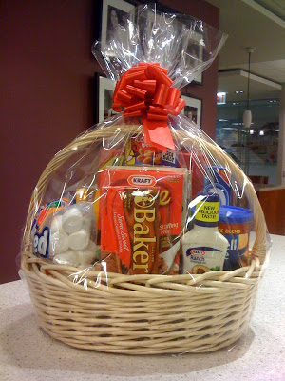
Upcoming Events
Suggestions:
Bath and Body Basket
Movie Basket
Candy Basket
Sports Basket
Car Basket
Cheese and Bread Basket
Baking Basket
CNH Division 14 Blue Robots

Slide 15
Upcoming Events
Key Club Week (Nov. 10th)
Friday- Thank you notes
to teachers (Part 2)
Afterschool in Mr. Moore’s
Classroom @ 3:30 PM
Friday 11/10/2017
CNH Division 14 Blue Robots

Slide 16
Upcoming Events
Key Club T-Shirts
Now available at the Student Store for $12
If you got one at Fall Rally, you can pay at the Student Store!
CNH Division 14 Blue Robots

Slide 17
Upcoming Events
Food Fair
November 17th (Friday)
Selling hot dogs
Need donations: Foil, chips and drinks (small pack size)
CNH Division 14 Blue Robots

Slide 18
Upcoming Events
Trick or Treat Boxes for UNICEF
Handing out today and this week
Must write your name on the sheet to get 1
1 full box = 1 hr
Due by November 1st (Tomorrow)
CNH Division 14 Blue Robots

Slide 19
Upcoming Events
UNICEF
What is it and why should you help?
Maternal and neonatal tetanus (MNT) kills one baby every nine minutes — that's 60,000 babies every year who will never grow up, make their mothers laugh, play with friends or dream about the future. The effects of the disease are excruciating — tiny newborns suffer repeated, painful convulsions and extreme sensitivity to light and touch. A significant number of women die from MNT each year too. It only takes $1.80 to vaccinate a mother from this disease and save her and her unborn children's lives.
CNH Division 14 Blue Robots

Slide 20
SPIRIT CHEERS!
HOW DO YOU FEEL?
I (we) FEEL GOOD, OH I (we) FEEL SO GOOD
*pelvic thrust* UGH!
I (we) FEEL FINE, ALL OF THE TIME
*fist pump while turning in circle*ABOOGA! ABOOGA! ABOOGA-BOOGA-BOOGA!!
CNH Division 14 Blue Robots

Slide 21
SPIRIT CHEERS!
REMIX ***When someone says “REMIX!”***
Hold up, wait a minute
Let me put some robot in it
*do the robot* Oh, some robot, oh, oh, some robot
CNH Division 14 Blue Robots

Slide 22
Treasurer’s Report
Club dues
$11.50
$3.50 donation to club
CNH Division 14 Blue Robots

Slide 23
Friendly Reminders
Please make sure you sign in with the event chair when you get to a service event or else you hours WILL NOT be counted!
Please make sure that if you sign up for an event, you come because when you sign up you are making a commitment and your other members will be counting on you!
If you signed up for an event, but cannot make it to the event, make sure you let an officer, advisor, or the event chair know!
If you did not sign up for an event, but are planning on attending, please contact an officer, advisor, or the event chair, letting us know you will be attending
CNH Division 14 Blue Robots

Slide 24
Upcoming Events
Articles & Visuals
Consists of:
3 candid (NOT POSED) pics
A paragraph describing it
*Send your finished work to the Editor at yc.kc.editor@gmail.com
*Must submit them before November 10th
*Can possibly be included in the CNH newsletter
CNH Division 14 Blue Robots

Slide 25
Contact Us
OFFICER CONTACT INFORMATION
Lieutenant Governor – d14.cnhkc.ltg@gmail.com
PRESIDENT – yc.kc.president@gmail.com
VICE PRESIDENT – yc.kc.vicepres@gmail.com
SECRETARY – yc.kc.secretary@gmail.com
TREASURER – yc.kc.treasurer@gmail.com
EDITOR – yc.kc.editor@gmail.com
IF YOU HAVE ANY PICTURES FROM SERVICE EVENTS, WE WANT THEM!!! PLEASE SEND THEM TO THE CLUB EDITOR, OR OTHER OFFICERS SO WE CAN PUT THEM IN NEWSLETTERS, THE CLUB WEBSITE, ETC.!!!
CNH Division 14 Blue Robots

Slide 26
Chair Reminders
IF YOU CHAIR AN EVENT:
Please make sure you send the ACCURATE hours report to the club secretary, SAM, by EMAIL
yc.kc.secretary@gmail.com
CNH Division 14 Blue Robots

Slide 27
Social Media
@ychskeyclub
@ychskc
http://goo.gl/XOOn4e
Enter #: 81010
Text: @yckc
CNH Division 14 Blue Robots

Slide 28
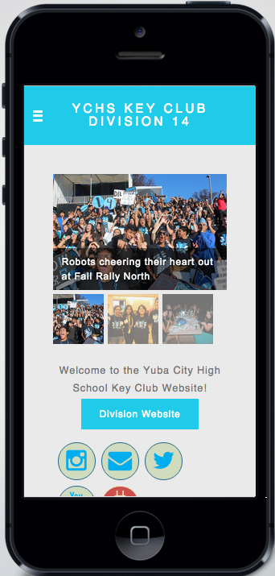
Social Media
WEBSITE
ychskeyclub14.weebly.com
CNH Division 14 Blue Robots

Slide 29
Questions?
Compliments?
Jokes?
Concerns?
Comments?
CNH Division 14 Blue Robots

