Slide 1
YCHS Key Club Meeting
October 2nd, 2017
Division 14 Blue Robots

Slide 2
Pledges
KEY CLUB PLEDGE
I pledge on my honor to uphold the objects of Key Club International;
To build my home school and community;
To serve my nation and god;
And to combat all forces which tend to undermine these institutions

Slide 3
SAVE THE DATES! Major Events!
NEXT EVENT: Fall Rally North – October 21st
Candidate Training Conference (CTC) – December 9th
District Officer Candidate Training Conference (DOCTC) – December 10th
Conclave - January
District Convention (DCON) – April 13-15 in Reno, NV
CNH Division 14 Blue Robots

Slide 4
Region/ Division Events
Fall Rally North 2017
**Must complete a minimum of 10 service hours by OCTOBER 21st to attend**
***Has to be paid by OCTOBER 2nd (TODAY)***
Receiving NO LATER THAN THIS FRIDAY
Cost: $34
@ Six Flags Discovery Kingdom
CNH Division 14 Blue Robots

Slide 5
Region/ Division Events
Fall Rally North 2017
What is it and why should you go?
(Hint: Not just because it’s at Six Flags!!)
Fall Rally North is a rally to raise money for the Pediatric Trauma Program. It’s the biggest fundraiser of the entire year, and we even auction off Lieutenant Governors, Leadership Team Members, and Executives. It is one big spirit competition where Divisions get to dress up in their favorite spirit wear and show off their spirit gear. You also get to meet Key Clubbers just like you from all over NorCal and Northern Nevada, and hopefully make new friends!
CNH Division 14 Blue Robots

Slide 6
Upcoming Events
Riverbend School Tutoring
Mondays – Thursdays
Starting October 16th, after school
3:30-4:45
CNH Division 14 Blue Robots

Slide 7
Upcoming Events
Float Building
October 3rd-5th (TODAY-THURSDAY)
In quad
3:30PM – 7:30PM
CNH Division 14 Blue Robots

Slide 8
Upcoming Events
Homecoming Float Parade
October 6th (FRIDAY)
3:30PM – 4PM
***COME WALK WITH US***
CNH Division 14 Blue Robots

Slide 9
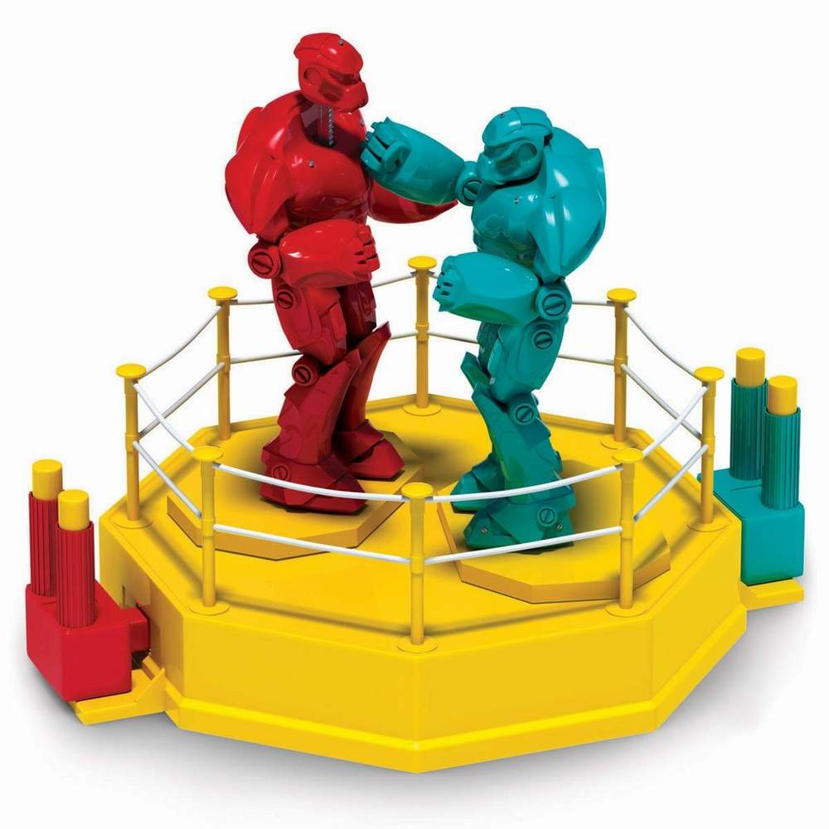
Upcoming Events
Rock-EM-Sock-EM Float
Bring that to life
1 side would be us & other would be the opposing team
CNH Division 14 Blue Robots

Slide 10
Upcoming Events
DIVISON COUNICIL/SPIRIT MEETING ***MANDATORY MEETING FOR FALL RALLY***
October 13th, 2017
5PM
@ YC MP ROOM
CNH Division 14 Blue Robots

Slide 11
Upcoming Events
Glam Girls
October 28th, 2017
9AM-2PM
At The Refuge Restaurant
CNH Division 14 Blue Robots

Slide 12
Upcoming Events
Playzeum
Signed up to volunteer @ yubasutterplay.org
CNH Division 14 Blue Robots

Slide 13
Upcoming Events
Trick or Treat Boxes for UNICEF
Handing out today and this week
Must write your name on the sheet to get 1
1 full box = 1 hr
CNH Division 14 Blue Robots

Slide 14
Upcoming Events
UNICEF
What is it and why should you help?
Maternal and neonatal tetanus (MNT) kills one baby every nine minutes — that's 60,000 babies every year who will never grow up, make their mothers laugh, play with friends or dream about the future. The effects of the disease are excruciating — tiny newborns suffer repeated, painful convulsions and extreme sensitivity to light and touch. A significant number of women die from MNT each year too. It only takes $1.80 to vaccinate a mother from this disease and save her and her unborn children's lives.
CNH Division 14 Blue Robots

Slide 15
SPIRIT CHEERS!
HOW DO YOU FEEL?
I (we) FEEL GOOD, OH I (we) FEEL SO GOOD
*pelvic thrust* UGH!
I (we) FEEL FINE, ALL OF THE TIME
*fist pump while turning in circle*ABOOGA! ABOOGA! ABOOGA-BOOGA-BOOGA!!
CNH Division 14 Blue Robots

Slide 16
SPIRIT CHEERS!
REMIX ***When someone says “REMIX!”***
Hold up, wait a minute
Let me put some robot in it
*do the robot* Oh, some robot, oh, oh, some robot
CNH Division 14 Blue Robots

Slide 17
SPIRIT CHEERS!
DIVISION CHEERS
Step aside while we rock this scene
Hey! We're Division 14!
We are the robots black and blue
Community service is what we do!
BOOGA BOOGA WAH WAH
We're taking over CALI-NEV-HA!
CNH Division 14 Blue Robots

Slide 18
SPIRIT CHEERS!
DIVISION STOMP
*POWER ON BLUE ROBOTS*
Scroll up, scroll, down
If there was a spirit crown
D14 would rule this town
With a scroll up, scroll down
Our spirit 'bout to drown this town
With a click here and a click there
You bet we got the best spirit here
​*stomp stomp clap clap stomp clap*
CNH Division 14 Blue Robots

Slide 19
Upcoming Events
KEY CLUB WEEK
November 6-10, 2017

Slide 20
Treasurer’s Report
Club dues
$11.50
$3.50 donation to club
CNH Division 14 Blue Robots

Slide 21
Friendly Reminders
Please make sure you sign in with the event chair when you get to a service event or else you hours WILL NOT be counted!
Please make sure that if you sign up for an event, you come because when you sign up you are making a commitment and your other members will be counting on you!
If you signed up for an event, but cannot make it to the event, make sure you let an officer, advisor, or the event chair know!
If you did not sign up for an event, but are planning on attending, please contact an officer, advisor, or the event chair, letting us know you will be attending
CNH Division 14 Blue Robots

Slide 22
Contact Us
OFFICER CONTACT INFORMATION
Lieutenant Governor – d14.cnhkc.ltg@gmail.com
PRESIDENT – yc.kc.president@gmail.com
VICE PRESIDENT – yc.kc.vicepres@gmail.com
SECRETARY – yc.kc.secretary@gmail.com
TREASURER – yc.kc.treasurer@gmail.com
EDITOR – yc.kc.editor@gmail.com
IF YOU HAVE ANY PICTURES FROM SERVICE EVENTS, WE WANT THEM!!! PLEASE SEND THEM TO THE CLUB EDITOR, OR OTHER OFFICERS SO WE CAN PUT THEM IN NEWSLETTERS, THE CLUB WEBSITE, ETC.!!!
CNH Division 14 Blue Robots

Slide 23
Chair Reminders
IF YOU CHAIR AN EVENT:
Please make sure you send the ACCURATE hours report to the club secretary, MAISIE, by EMAIL
yc.kc.secretary@gmail.com
CNH Division 14 Blue Robots

Slide 24
Social Media
@ychskeyclub
@ychskc
http://goo.gl/XOOn4e
Enter #: 81010
Text: @yckc
CNH Division 14 Blue Robots

Slide 25
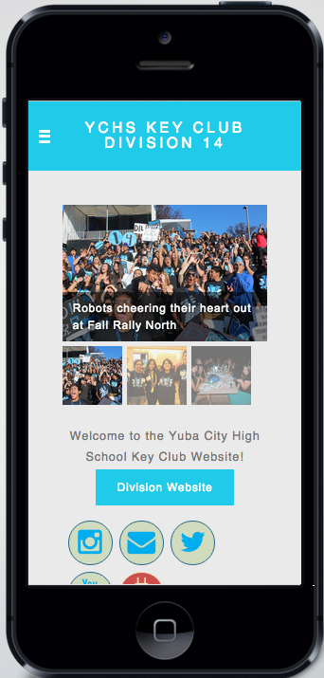
Social Media
WEBSITE
ychskeyclub14.weebly.com
CNH Division 14 Blue Robots

Slide 26
Questions?
Compliments?
Jokes?
Concerns?
Comments?
CNH Division 14 Blue Robots

