Slide 1
YCHS Key Club Meeting
November 14th, 2017
Division 14 Blue Robots

Slide 2
Pledges
KEY CLUB PLEDGE
I pledge on my honor to uphold the objects of Key Club International;
To build my home school and community;
To serve my nation and god;
And to combat all forces which tend to undermine these institutions

Slide 3
Recap Events
Key Club Week (Monday-Friday)
UNICEF Box Counting So Far
Thank You Notes to Teachers So Far
CNH Division 14 Blue Robots

Slide 4
SAVE THE DATES! Major Events!
NEXT EVENT: Candidate Training Conference (CTC) – December 9th
District Officer Candidate Training Conference (DOCTC) – December 10th
Conclave - January
District Convention (DCON) – April 13-15 in Reno, NV
CNH Division 14 Blue Robots

Slide 5
Upcoming Events
Riverbend School Tutoring
Mondays – Thursdays
3:30-4:45
Please check in Juan Juarez
Need more volunteers Mondays, Tuesdays, Thursdays
CNH Division 14 Blue Robots

Slide 6
Upcoming Events
Playzeum
Sign up to volunteer @ yubasutterplay.org
Please check in with Staci Howell
Located @ 1980 S Walton Ave, Yuba City, CA, 95591
CNH Division 14 Blue Robots

Slide 7
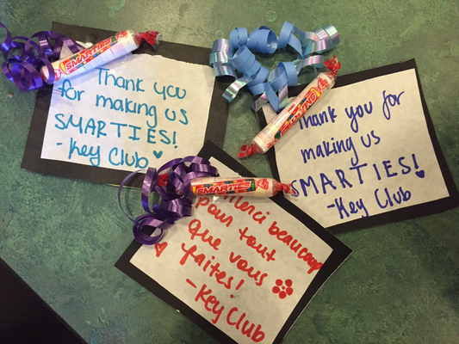
Upcoming Events
Thank You Notes to Teachers Day 2
Afterschool @ 3:30 PM
In Mr. Moore’s
Classroom (Rm. 403)
CNH Division 14 Blue Robots

Slide 8
Upcoming Events
UNICEF Box Count Day 2
Tomorrow (Wednesday)
Afterschool in Mr. Moore’s Classroom(Rm. 403)
CNH Division 14 Blue Robots

Slide 9
Upcoming Events
Trick or Treat UNICEF Boxes
If your name is on this list please turn in your boxes!
CNH Division 14 Blue Robots

Slide 10
List of People
Prabhnoor Kaur
Garrin Dhami
Lily Marshall
Parminder Kaur
Jasmeet Jande
Ramneet Jande
CNH Division 14 Blue Robots

Slide 11
Upcoming Events
Key Club T-Shirts
Now available at the Student Store for $12
If you got one at Fall Rally, you can pay at the Student Store!
CNH Division 14 Blue Robots

Slide 12
Upcoming Events
T-Shirts
If your name is on this list please turn in your money to the student store!
CNH Division 14 Blue Robots

Slide 13
List of People
Athina Dumaran
Parminder Kaur
Amit Lally
Alyssa Tinoco
Andrew Williams
CNH Division 14 Blue Robots

Slide 14
Upcoming Events
Food Fair
November 17th (THIS Friday)
Selling hot dogs and cookies
CNH Division 14 Blue Robots

Slide 15
Upcoming Events
What We Need:
Many members for prepping and working the booths
Donations: Foil, chips, cookies, and drinks (small pack size)
CNH Division 14 Blue Robots

Slide 16
Upcoming Events
DCM (Division Council Meeting)
November 17th (THIS Friday)
Location: Gridley High School
Arrive at 6 PM
Theme: Fall
CNH Division 14 Blue Robots

Slide 17
Upcoming Events
Gift of Giving
***Hosted by Sac State Circle K***
November 18 (THIS SATURDAY)
Location: CSU Sacramento
From 9:30 AM-4 PM
CNH Division 14 Blue Robots

Slide 18
Upcoming Events
What We’ll Be Doing:
Doing Motivational/Thanksgiving Cards
Doing No-Sew Scarves, Pillowcases, and Hats
Making care packages and candy turkeys
Ice breakers and games
CNH Division 14 Blue Robots

Slide 19
SPIRIT CHEERS!
HOW DO YOU FEEL?
I (we) FEEL GOOD, OH I (we) FEEL SO GOOD
*pelvic thrust* UGH!
I (we) FEEL FINE, ALL OF THE TIME
*fist pump while turning in circle*ABOOGA! ABOOGA! ABOOGA-BOOGA-BOOGA!!
CNH Division 14 Blue Robots

Slide 20
SPIRIT CHEERS!
REMIX ***When someone says “REMIX!”***
Hold up, wait a minute
Let me put some robot in it
*do the robot* Oh, some robot, oh, oh, some robot
CNH Division 14 Blue Robots

Slide 21
Treasurer’s Report
Club dues
$11.50
$3.50 donation to club
CNH Division 14 Blue Robots

Slide 22
Friendly Reminders
Please make sure you sign in with the event chair when you get to a service event or else you hours WILL NOT be counted!
Please make sure that if you sign up for an event, you come because when you sign up you are making a commitment and your other members will be counting on you!
If you signed up for an event, but cannot make it to the event, make sure you let an officer, advisor, or the event chair know!
If you did not sign up for an event, but are planning on attending, please contact an officer, advisor, or the event chair, letting us know you will be attending
CNH Division 14 Blue Robots

Slide 23
Upcoming Events
Articles & Visuals
Consists of:
3 candid (NOT POSED) pics
A paragraph describing it
*Send your finished work to the Editor at yc.kc.editor@gmail.com
*Must submit them before November 10th
*Can possibly be included in the CNH newsletter
CNH Division 14 Blue Robots

Slide 24
Contact Us
OFFICER CONTACT INFORMATION
Lieutenant Governor – d14.cnhkc.ltg@gmail.com
PRESIDENT – yc.kc.president@gmail.com
VICE PRESIDENT – yc.kc.vicepres@gmail.com
SECRETARY – yc.kc.secretary@gmail.com
TREASURER – yc.kc.treasurer@gmail.com
EDITOR – yc.kc.editor@gmail.com
IF YOU HAVE ANY PICTURES FROM SERVICE EVENTS, WE WANT THEM!!! PLEASE SEND THEM TO THE CLUB EDITOR, OR OTHER OFFICERS SO WE CAN PUT THEM IN NEWSLETTERS, THE CLUB WEBSITE, ETC.!!!
CNH Division 14 Blue Robots

Slide 25
Chair Reminders
IF YOU CHAIR AN EVENT:
Please make sure you send the ACCURATE hours report to the club secretary, SAM, by EMAIL
yc.kc.secretary@gmail.com
CNH Division 14 Blue Robots

Slide 26
Social Media
@ychskeyclub
@ychskc
http://goo.gl/XOOn4e
Enter #: 81010
Text: @yckc
CNH Division 14 Blue Robots

Slide 27
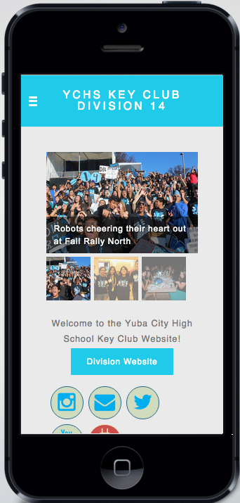
Social Media
WEBSITE
ychskeyclub14.weebly.com
CNH Division 14 Blue Robots

Slide 28
Questions?
Compliments?
Jokes?
Concerns?
Comments?
CNH Division 14 Blue Robots

