Slide 1
YCHS Key Club Meeting
December 5th, 2017
Division 14 Blue Robots

Slide 2
Pledges
KEY CLUB PLEDGE
I pledge on my honor to uphold the objects of Key Club International;
To build my home school and community;
To serve my nation and god;
And to combat all forces which tend to undermine these institutions

Slide 3
Recap Events
UNICEF Box Counting
Riverbend School Tutoring
Breakfast with Santa
CNH Division 14 Blue Robots

Slide 4
SAVE THE DATES! Major Events!
NEXT EVENT: Candidate Training Conference (CTC) – December 9th
District Officer Candidate Training Conference (DOCTC) – December 10th
Conclave - January
District Convention (DCON) – April 13-15 in Reno, NV
CNH Division 14 Blue Robots

Slide 5
Upcoming Events
Candidate Training Conference 2017
Location: Kiwanis Family House (2875 50th St, Sacramento, CA 95817)
Date and Time: December 9th, 2017 from 9AM-4PM
Registration: $5 which includes 1/2 sandwich, snacks, drink
***There are TWO forms you need to fill out to register!!!
Attire: Business Casual Attire for attendees
CNH Division 14 Blue Robots

Slide 6
Upcoming Events
Riverbend School Tutoring
Mondays – Thursdays
3:30-4:45
Please check in Juan Juarez
Need more volunteers Mondays, Tuesdays, Thursdays
CNH Division 14 Blue Robots

Slide 7
Upcoming Events
Playzeum
Sign up to volunteer @ yubasutterplay.org
Please check in with Staci Howell
Located @ 1980 S Walton Ave, Yuba City, CA, 95591
CNH Division 14 Blue Robots

Slide 8
Upcoming Events
Mel Good Tournament
2 days FREE admission (the day you volunteer plus 1 more day)
FREE food while you are working in the hospitality room
CNH Division 14 Blue Robots

Slide 9
Upcoming Events
Christmas Caroling
Dec. 21st (1PM-4PM)-Thursday
Dec. 22nd (1PM-4PM)-Friday
Dec. 23rd (10AM-2PM)-Saturday
***Please sign up to CAROL***
CNH Division 14 Blue Robots

Slide 10
Upcoming Events
DAYS AND SHIFTS
Thursday (Dec. 14th)
7:15PM-9:15PM
Saturday (Dec. 16th)
12:30PM-2:30PM
2:30PM-4:30PM
4:30PM-6:30PM
Friday (Dec. 15th)
3:15PM-5:15PM
5:15PM-7:15PM
7:15PM-9:15PM
CNH Division 14 Blue Robots

Slide 11
Upcoming Events
Trick or Treat UNICEF Boxes
If your name is on this list please turn in your boxes!
CNH Division 14 Blue Robots

Slide 12
List of People
Gissel Tena
Jasmeet Jande
CNH Division 14 Blue Robots

Slide 13
Upcoming Events
Key Club T-Shirts
Now available at the Student Store for $12
If you got one at Fall Rally, you can pay at the Student Store!
CNH Division 14 Blue Robots

Slide 14
Upcoming Events
T-Shirts
If your name is on this list please turn in your money to the student store!
CNH Division 14 Blue Robots

Slide 15
List of People
Athina Dumaran
Parminder Kaur
Amit Lally
Alyssa Tinoco
CNH Division 14 Blue Robots

Slide 16
Christmas Caroling!
We wish you a Merry Christmas
We wish you a Merry Christmas
And a Happy New Year!
CNH Division 14 Blue Robots

Slide 17
Treasurer’s Report
Club dues
$11.50
$3.50 donation to club
Lets report on our balance in our account and upcoming expenses
CNH Division 14 Blue Robots

Slide 18
Friendly Reminders
Please make sure you sign in with the event chair when you get to a service event or else you hours WILL NOT be counted!
Please make sure that if you sign up for an event, you come because when you sign up you are making a commitment and your other members will be counting on you!
If you signed up for an event, but cannot make it to the event, make sure you let an officer, advisor, or the event chair know!
If you did not sign up for an event, but are planning on attending, please contact an officer, advisor, or the event chair, letting us know you will be attending
CNH Division 14 Blue Robots

Slide 19
Contact Us
OFFICER CONTACT INFORMATION
Lieutenant Governor – d14.cnhkc.ltg@gmail.com
PRESIDENT – yc.kc.president@gmail.com
VICE PRESIDENT – yc.kc.vicepres@gmail.com
SECRETARY – yc.kc.secretary@gmail.com
TREASURER – yc.kc.treasurer@gmail.com
EDITOR – yc.kc.editor@gmail.com
IF YOU HAVE ANY PICTURES FROM SERVICE EVENTS, WE WANT THEM!!! PLEASE SEND THEM TO THE CLUB EDITOR, OR OTHER OFFICERS SO WE CAN PUT THEM IN NEWSLETTERS, THE CLUB WEBSITE, ETC.!!!
CNH Division 14 Blue Robots

Slide 20
Chair Reminders
IF YOU CHAIR AN EVENT:
Please make sure you send the ACCURATE hours report to the club secretary, SAM, by EMAIL
yc.kc.secretary@gmail.com
CNH Division 14 Blue Robots

Slide 21
Social Media
@ychskeyclub
@ychskc
http://goo.gl/XOOn4e
Enter #: 81010
Text: @yckc
CNH Division 14 Blue Robots

Slide 22
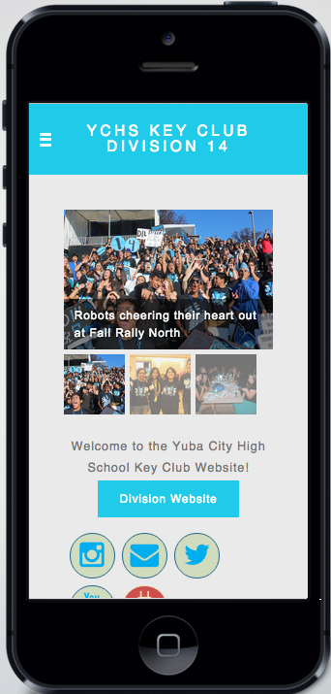
Social Media
WEBSITE
ychskeyclub14.weebly.com
CNH Division 14 Blue Robots

Slide 23
Questions?
Compliments?
Jokes?
Concerns?
Comments?
CNH Division 14 Blue Robots

