Slide 1
YCHS Key Club Meeting
August 22nd, 2017
Division 14 Blue Robots

Slide 2
Pledges
KEY CLUB PLEDGE
I pledge on my honor to uphold the objects of Key Club International;
To build my home school and community;
To serve my nation and god;
And to combat all forces which tend to undermine these institutions

Slide 3
Recap of Events
Graffiti Clean Up
June DCM and Summer Stroll
July DCM and Robot Olympics
iCan Bike Camp
Lincrest Library
CNH Division 14 Blue Robots

Slide 4
THE BIG QUESTION
Do you make keys or something?
(in short, NO)
KEY stands for Kiwanis Education Youth
CNH Division 14 Blue Robots

Slide 5
MISSION: Key Club is an international,
student-led organization providing its
members with opportunities to perform
service, build character, and develop
leadership.
VISION: We are caring and competent
servant-leaders transforming
communities world-wide.
CNH Division 14 Blue Robots

Slide 6
HISTORY
Key Club was started by Albert C. Olney and
Frank C. Vincent on May 7, 1925 at Sacramento
High School in Sacramento, CA.
Sacramento High School still has an active Key
Club.
They approached a neighboring Kiwanis club to
help charter a similar club for service at their high
school.
CNH Division 14 Blue Robots

Slide 7
Motto: “CARING – Our way of life”
Core Values
Caring
Character Building
Inclusiveness
Leadership
Key Club Colors
Blue – Unwavering Character
White – Purity
Gold – Service
CNH Division 14 Blue Robots

Slide 8
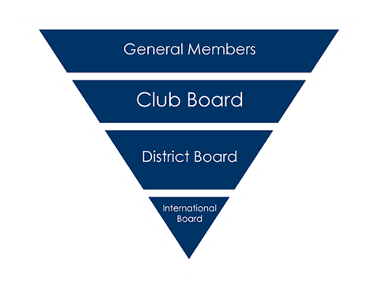
KEY CLUB STRUCTURE
It starts with YOU!
Members make up a club.
A board is elected/appointed based on Club Bylaws that are updated/signed at the beginning of every year.
Multiple clubs make up a division.
Multiple divisions make up a region.
The regions make up a district.
All of the Districts make up International
CNH Division 14 Blue Robots

Slide 9
WE ARE THE CNH DISTRICT BEES
In the California-Nevada-Hawaii District:
+43,000 members
+700 clubs
77 divisions
18 regions
Serving the District:
District Governor: Angelica Garcia
District Secretary: Jimin Margarett Lee
District Treasurer: Vivian Chu
CNH Division 14 Blue Robots

Slide 10
APPOINTED BOARD MEMBERS
District News Editor: Zoe Yao
District Tech Editor: Roland Del Mundo
Communications & Marketing Chair: Gaby Yonarta
District Convention Chair: Samantha Voong
Kiwanis Family and Foundation Chair: Jesus Aguiniga
Member Recognition Chair: Charlotte Wood
Member Relations Chair: Johnny Chen
Policy, International Business, & Elections Chair: Kai Catarata
Service Projects Chair: Alex Gatus
Graphics Department Coordinator: Trinity Tran Nguyen
Key Leader Coordinator: Lindy Chen
Sergeant-at-Arms Coordinator: Eduardo Torres
CNH Division 14 Blue Robots

Slide 11
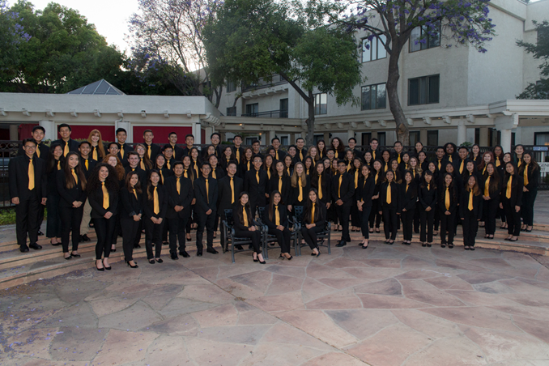
DISTICT BOARD
Lt. Governors from 77 Divisions within CNH
Appointed Board Members
District Executives
CNH Division 14 Blue Robots

Slide 12
Key Club International
33 Districts make up Key Club International.
The International Council is made up of the International President, International Vice President, 11 International Trustees, and 33 District Governors.
The International Board is made up of the International President, International Vice President, and 11 International Trustees
International President: William Sims
International Vice President: Minyoung Kim
Trustees
Lindsey Banks
Audrey Dilgarde
Jared Dutko
Luke Gilmore
Rohan Mekala
Jack Nannie
Caleb Neale
Alisa Nguyen
Saul Ontiveros
Emily Rice
Nhung Tran
CNH Division 14 Blue Robots

Slide 13
TOGETHER WE ARE…
276,000+ Members
5,000+ Clubs
33 Districts
38 Countries
1 Organization
CNH Division 14 Blue Robots

Slide 14
Key Club International has 4 Preferred Charities:
Children’s Miracle Network
March of Dimes
UNICEF / eliMiNaTe / MNT
The Thirst Project
CNH PREFERRED CHARITY
PEDIATRIC TRAUMA PROGRAM
CNH Division 14 Blue Robots

Slide 15
Major Events
Region Training Conference (RTC) – Sept 22-23
Fall Rally (FRN) – Oct 21
Candidate Training Conference (CTC) – Beginning of December
District Officer Candidate Training Conference (DOCTC) – Beg of Dec
Conclave - January
District Convention (DCON) – April 13-15 in Reno, NV
CNH Division 14 Blue Robots

Slide 16
Key Club is the largest service organization in the world for high school students.
This experience can be life-changing! It is what you put into it!
SO many amazing opportunities are provided through Key Club
Easy way to get service hours! There is always something going on!
Teaches you leadership skills and so many other useful things!
WHAT WILL YOUR KEY CLUB MOMENT BE?
CNH Division 14 Blue Robots

Slide 17
AUGUST DCM
AUGUST 25 AT RVHS AT 5PM
PTP FUNDRAISER AND MOVIE NIGHT
DOCTOR STRANGE, SNACKS, DONATIONS
CNH Division 14 Blue Robots

Slide 18
Division Updates
Division Leadership Team (DLT) Applications
Want to be a part of the 2017-2018 DLT and help plan out division events and projects?
Please talk to LTG Lily, officer, or advisor for info on how to sign up!
CNH Division 14 Blue Robots

Slide 19
Division Updates
Division Leadership Team (DLT) Applications
Open Positions: Division Assistant (2), News Editor, Secretary, Communications and Marketing Coordinator, Member Recognition Coordinator, Member Relations Coordinator, PTP Coordinator
CNH Division 14 Blue Robots

Slide 20
Treasurer’s Report
Club dues
$11.50
$3.50 donation to club
CNH Division 14 Blue Robots

Slide 21
Friendly Reminders
Please make sure you sign in with the event chair when you get to a service event or else you hours WILL NOT be counted!
Please make sure that if you sign up for an event, you come because when you sign up you are making a commitment and your other members will be counting on you!
If you signed up for an event, but cannot make it to the event, make sure you let an officer, advisor, or the event chair know!
If you did not sign up for an event, but are planning on attending, please contact an officer, advisor, or the event chair, letting us know you will be attending
CNH Division 14 Blue Robots

Slide 22
Contact Us
OFFICER CONTACT INFORMATION
Lieutenant Governor – d14.cnhkc.ltg@gmail.com
PRESIDENT – yc.kc.president@gmail.com
VICE PRESIDENT – yc.kc.vicepres@gmail.com
SECRETARY – yc.kc.secretary@gmail.com
TREASURER – yc.kc.treasurer@gmail.com
EDITOR – yc.kc.editor@gmail.com
IF YOU HAVE ANY PICTURES FROM SERVICE EVENTS, WE WANT THEM!!! PLEASE SEND THEM TO THE CLUB EDITOR, OR OTHER OFFICERS SO WE CAN PUT THEM IN NEWSLETTERS, THE CLUB WEBSITE, ETC.!!!
CNH Division 14 Blue Robots

Slide 23
Chair Reminders
IF YOU CHAIR AN EVENT:
Please make sure you send the ACCURATE hours report to the club secretary, MAISIE, by EMAIL
yc.kc.secretary@gmail.com
CNH Division 14 Blue Robots

Slide 24
Social Media
@ychskeyclub
@ychskc
http://goo.gl/XOOn4e
Enter #: 81010
Text: @yckc
CNH Division 14 Blue Robots

Slide 25
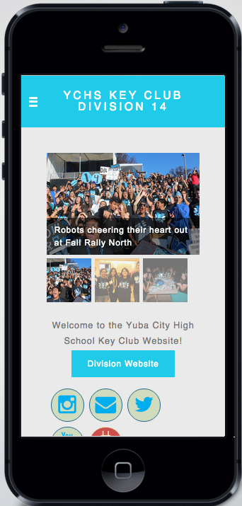
Social Media
SNAPCHAT
ychskeyclub
WEBSITE
ychskeyclub14.weebly.com
CNH Division 14 Blue Robots

Slide 26
Questions?
Compliments?
Jokes?
Concerns?
Comments?
CNH Division 14 Blue Robots

